Slide 1

Global Academy of Technology Department of Computer Science and Engineering
Technical Seminar (15CSS86)
Contactless Monitoring Of Pulse Rate And Eye Movement For Uveal Melanoma Patients Undergoing Radiation Therapy
Name : PRAJWAL KL
USN : 1GA15CS105
Guide : Mrs. JYOTHI R
Assistant Professor
Dept. of CSE, GAT

Slide 2
Index
Objective
Abstract
Introduction
Technologies Used
Implementation/Issues/Applications
Comparison Results (if any)
Conclusion & Future Scope
Bibliography / References

Slide 3
Objectives
CANCER is the leading cause of death in the world for years. Half of the cancer patients need radiation therapy(RT) in the whole treatment course.
During radiation treatment, patients are required to stay alone in the treatment room to protect others from radiation exposure.
So far, no efficient and standard procedure can be used to detect the eye movement easily, considering the equipment and cost of the existing treatment environment. The video based method seems to be the most suitable way for a long treatment measurement.

Slide 4
Abstract
Ensuring eye immobilization and monitoring vital signs are crucial for melanoma patients undergoing Radiation Therapy(RT).
Current clinical use of an artificial way to observe eye movement and to access vital signals relies on the use of contact sensors.

Slide 5
Introduction
CANCER is the leading cause of death in the world for years. Half of the cancer patients need radiation therapy(RT) in the whole treatment course.
Uveal melanoma is a rare disease but is the most common primary ocular malignancy.
The primary treatment is to control tumor by stereotactic radiosurgery(SRS), which is an alternative option to enucleation and could achieve good outcomes.
Therapist can only obtain patient’s eye movements by observing the video in the control room.

Slide 6
Introduction
There are 4 common methods to measure eyeball movement:
1.Video Based Eye Tracker.
2.Scleral Search Coil.
3.Electro-Oculography.
4.Infrared Oculography.

Slide 7
Methods
Eyeball Detection And Tracking
Pulse Rate Measurement
1.Select Region of Interest(ROIrPPG)
2.Feature Detection and Tracking
3.Obtain rPPG Signal
4.Infinite Impulse Response(IIR) Filtering
5.Fast Fourier Transform(FFT) Spectrum
Environment Impulse Response Filtering

Slide 8
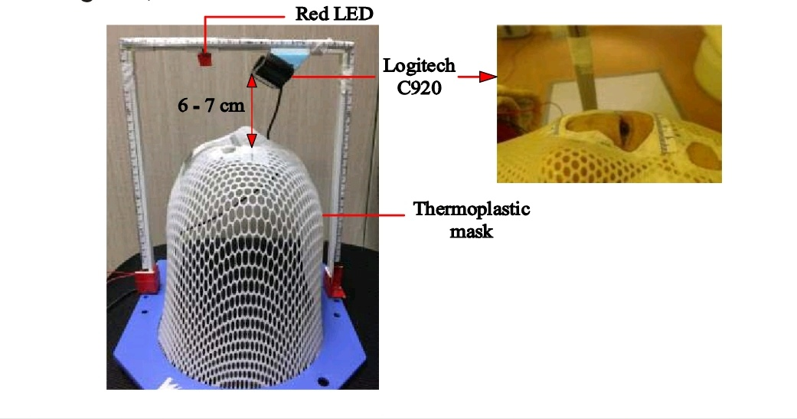
Methods
To monitor eyeball movement and physiological signals , an adjustable camera fixation system was designed
Fig : camera was fixed above the thermoplastic mask to capture the video during radiosurgery to uveal melanoma.

Slide 9
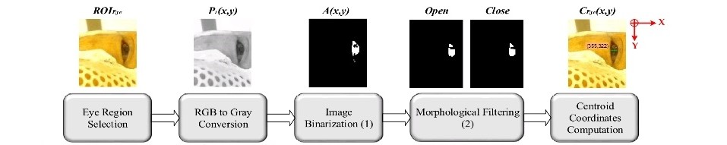
A . Eyeball Detection and Tracking
Fig :data workflow of eyeball tracking
Fig :data workflow of eyeball tracking

Slide 10
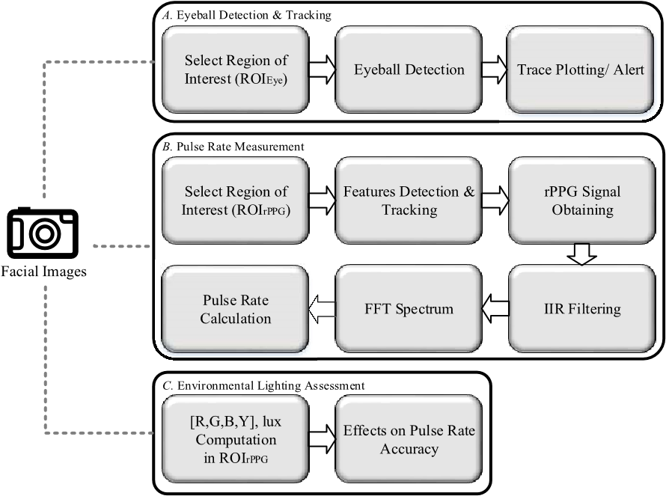
B . Pulse Rate Measurement
Fig: data workflow of pulse rate measurement

Slide 11
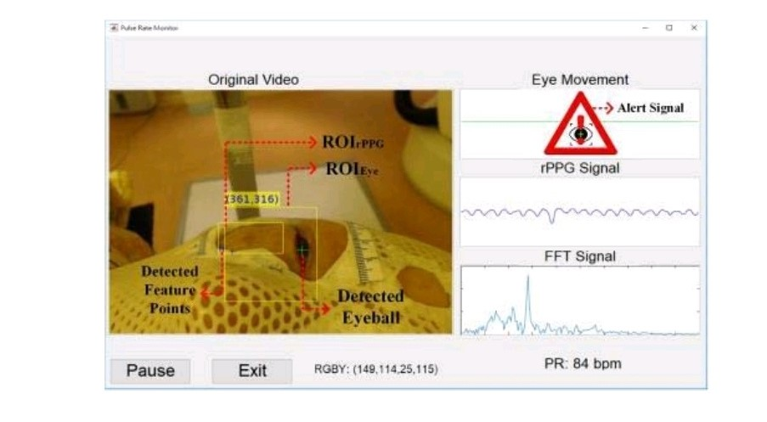
Fig .3. Proposed framework was conducted and designed with MATLAB GUI toolbox

Slide 12
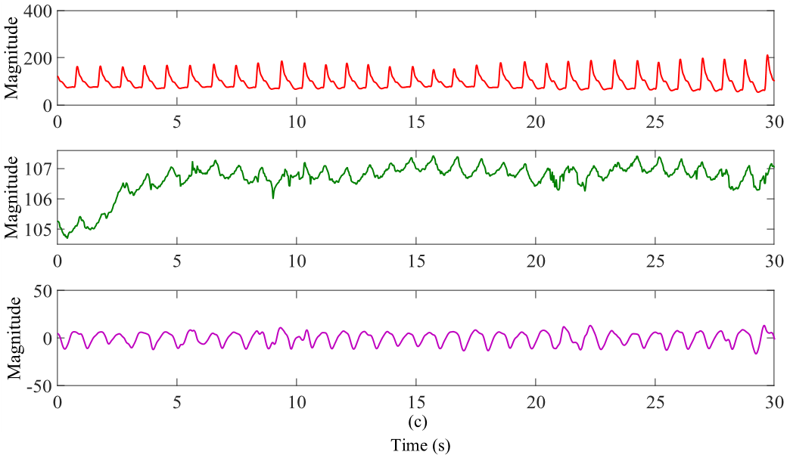
Fig : Contact-based PPG waveform and captured contactless rPPG signal.
(a) PPG waveform captured from the contact pulse oximetry sensor .
(b) Synchronized rPPG raw signal captured from the consecutive facial video.
(c) IIR bandpass filtered version rPPG waveform.

Slide 13
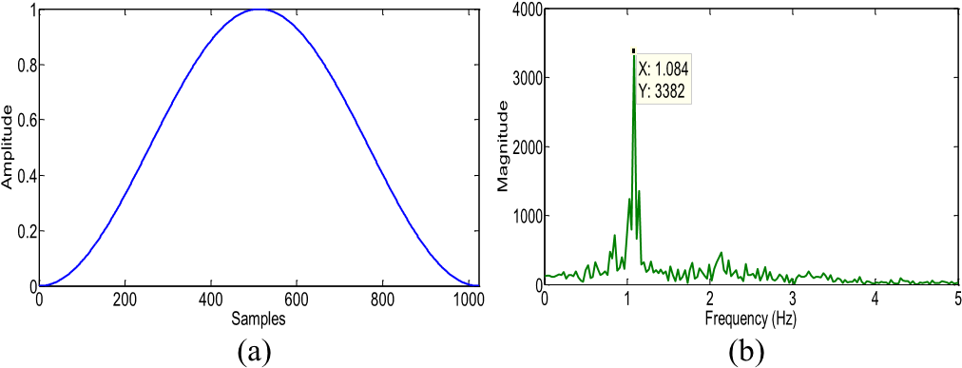
Fig : FFT frequency spectrum.
(a) Adopted Hann window function.
(b) Transformed spectrum to present the detected pulse rate as maximum spike location.

Slide 14
C . Environment lighting Assessment
Unstable or insufficient lighting can induce a great deal of disturbance on the rPPG signal .
The selected ROI also contains the luminance information of the treatment room.

Slide 15
Technologies Used
Artificial Intelligence :
The theory and development of computer systems able to perform tasks normally requiring human intelligence, such as visual perception, speech recognition, decision-making.
Image Processing :
Image processing is a method to perform some operations on an image, in order to get an enhanced image or to extract some useful information from it

Slide 16
Implementation
A. Evaluating the Accuracy of Tracking Eyeball Movement:
Since it is hard to confirm the real eye position on treatment videos without reliable qualification tools , we adopted a database to validate the accuracy of the proposed eye detection method.

Slide 17
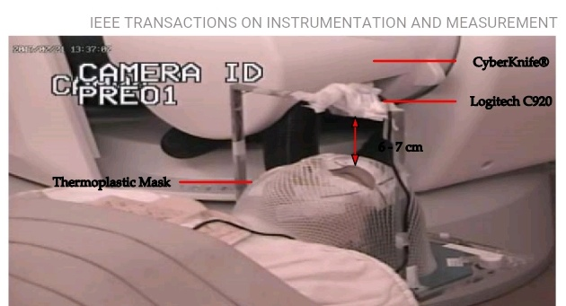
B. Clinical Trials
1.Experimental set up:
fig 5.Experimental setup for clinical trials

Slide 18
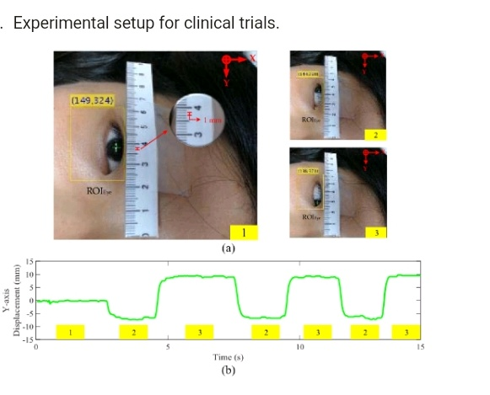
2.Evalution Metrics for eyeball Immobilization
Fig 6.eyeball movement estimation and calibration
(a) as the example here,1mm is approximately equal to 5 pixels.
(b) Instant eyeball movement track

Slide 19
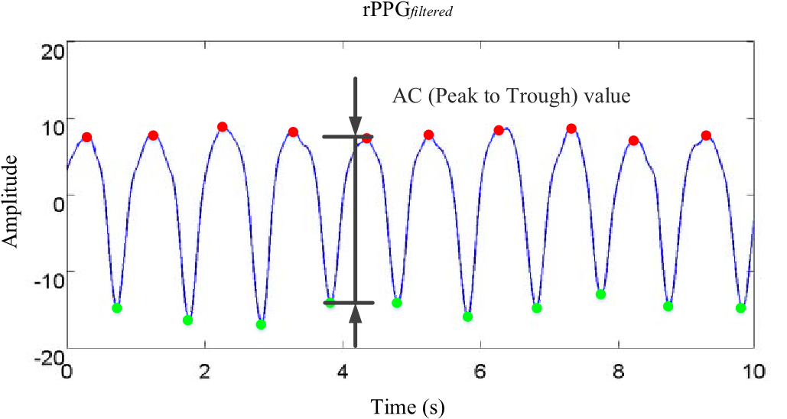
C. Light Source Evaluation
Fig. 9. Illustration of ac value obtained from the filtered version of the rPPG signal.

Slide 20
Comparison Results
Accuracy of Tracking Eyeball Movement:
The performance of the algorithm may vary by the
distance of the user from the camera.
Based on observation , the proposed method could provide a smaller error tracking the eyeball movement from the recruited taiwanese patients with darker iris color.

Slide 21
B . Clinical Trial:
The experimental results are divided into two parts:
1. The monitoring of eyeball movement
2. pulse rate detection accuracy.
1.Monitoring of Eyeball Movement :
Compared with the current method to surveil the eye movement with labor , the proposed methods are able to track the eyeball movement on a real-time basis to assist the therapist in securing the immobilization during RT.

Slide 22
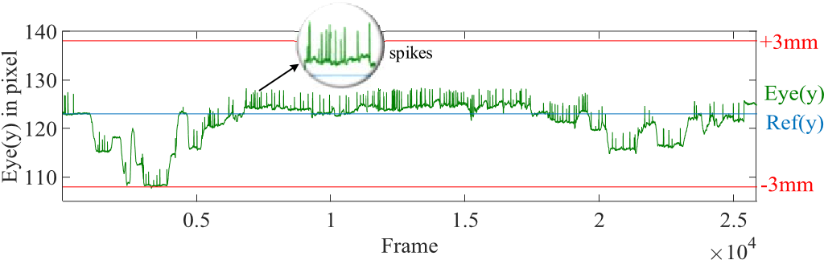
2 . Pulse Rate Detection Accuracy:
The obtained pulse rates were compared with pulse oximeter every second and the accuracy was averaged over time.
Fig : partial result of eyeball movement tracking from patient

Slide 23
Conclusion & Future Scope
A camera based measurement method was proposed to simultaneously monitor patient’s eyeball movement and pulse rate.
This method may improve the current clinical application and assist medical staffs on monitoring patient’s vital parameters more efficiently and quantitatively .

Slide 24
Bibliography
[1] . (2016). Health Promotion Administration Annual Report. [Online]. Available: https://www.hpa.gov.tw/EngPages/Detail.aspx?nodeid=
1072&pid=7138
[2] . W. R. Hendee and M. G. Herman, “Improving patient safety in radiation oncology,” Pract. Radiat. Oncol., vol. 1, no. 1, pp. 16–21, 2011.
[3] . Y. Negoro et al., “The effectiveness of an immobilization device in conformal radiotherapy for lung tumor: Reduction of respiratory tumor movement and evaluation of the daily setup accuracy,” Int. J. Radiat. Oncol. Biol. Phys., vol. 50, no. 4, pp. 889–898, 2001.
[4] . O. Iskanderani et al., “Reproducibility of a noninvasive system for eye positioning and monitoring in stereotactic radiotherapy of ocular melanoma,” Technol. Cancer Res. Treat., vol. 16, no. 3, pp. 352–356, 2017.

Slide 25
THANK YOU

